Slide 1
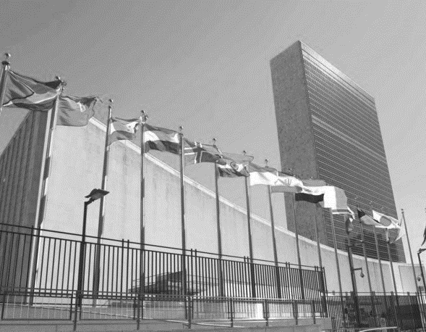
Global Governance and the New World Order
Dr Jonathan Leader Maynard
jonathan.leader_maynard@kcl.ac.uk
www.jleadermaynard.com @jleadermaynard

Slide 2
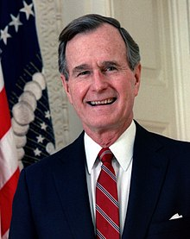
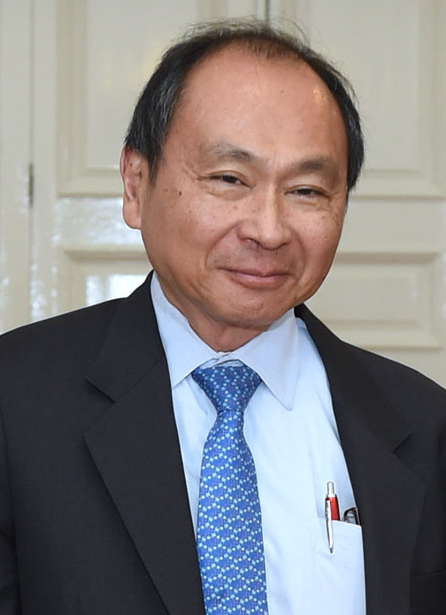
Imagining the Post-Cold War World
The “New World Order” (George Bush, 11 September 1990)
US strength, leadership and activism, not retrenchment.
US-Soviet partnership. Broader great power cooperation. Revival of United Nations and creation of international rule of law (e.g. Cambodia’s UN peace plan on 10 September).
Economic development now the key problem, not ideological conflict.
“Unipolar Moment” vs. “Unipolar Illusion” (Charles Krauthammer, 1990 vs. Christopher Layne, 2006)
Untrammelled US power, bandwagoning around US. Danger of future US isolationism. Or, inevitable balancing and return to multipolarity?
“The End of History” (Francis Fukuyama, 1992)
Triumph of liberal democracy and free markets
Decline of interstate war and ideological conflict
Future problems about transformations in technology.

Slide 3
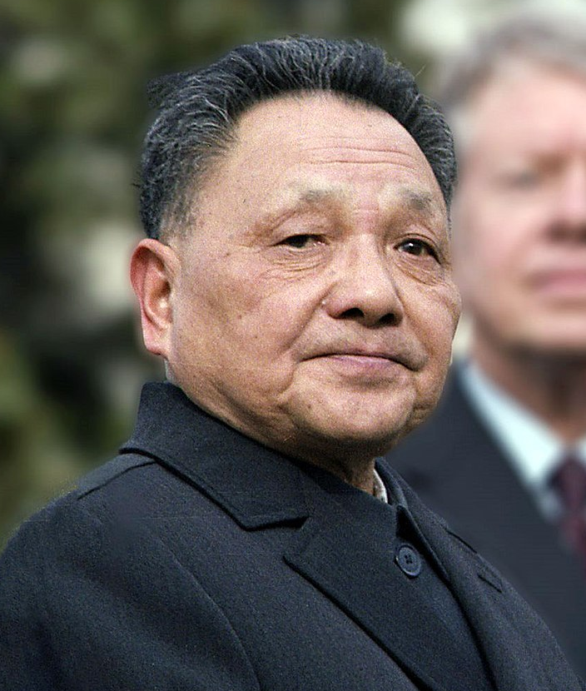
Imagining the Post-Cold War World
Towards the “Asian Century” (Deng Xiaoping, 1988)
Rise of China, India and Japan. Return of multipolarity.
Discrediting of western values and individualist capitalism
Mix of liberal markets and economically active states
The “New Medievalism” (Hedley Bull, 1977)
Erosion of state sovereignty by globalisation. Rise of non-state actors, privatised violence, fluid norms and legal orders.
Instability: porous borders; fragmentation, failed states; nationalism.
Link to New Wars thesis of Mary Kaldor (1999/2012).
“Repeating the 1920s” (Various, e.g. Browning 2018)
Period of liberal optimism, institutionalism, interdependence.
Followed by financial crisis; economic, developmental and environmental problems; vast New Wars conflict; retrenchment.
Failures of liberalism: democratic backsliding, underdevelopment, economic crisis, nationalist/religious conflict.

Slide 4
Institutions and Cooperation
Realist View (e.g. Mearsheimer)
Generally reflect states’ interests and power, little independent impacts.
Even if able to improve absolute gains, relative gains block cooperation.
Liberal View: (e.g. Abbott and Snidal)
Institutions lower several rational barriers to cooperation by:
‘Centralising’: By pooling resources, practices and negotiations, institutions can benefit from economies of scale, reduced transaction costs, coordination, etc.
‘Linkages’: By bundling agreements together, and increasing the ‘shadow of the future’, institutions increase states’ willingness to sacrifice for greater overall gains.
‘Laundering’/‘Legitimating’: conducting or authorising activities that would be controversial if done by states.
Increasing ‘start-up costs’ for alternative policy pathways.
Institutions functionally expand their activities over time.
Constructivist View: (e.g. Barnett & Finnemore)
Institutions both enhance cooperation and transform states’ interests by:
‘Epistemic Communities’: Institutions create networks of experts that states look to for advice in conditions of uncertainty.
‘Norms’: Institutions set, sustain or embody certain normative standards which states are incentivised to emulate, and eventually may internalise.
Institutions can also malfunction due to standard operating procedures, bureaucratic interests, etc.

Slide 5
The Growth of Global Governance

Slide 6
UN-Authorised Interventions
The Gulf War in Iraq/Kuwait (1990-91) – Operations Desert Shield and Desert Storm
Iraq occupies Kuwait on 2 August 1990, UN condemns occupation, and US organises and leads a UN-authorised coalition to evict Iraqi forces from 16 January 1991.
Northern Iraq (1991-1996) – Operation Provide Comfort
Iraq’s defeat in Gulf War leads Kurds and Shiites in Northern Iraq to rebel against Saddam Hussein. After this fails, refugees flee towards Turkish and Iranian borders fearing reprisals. US leads efforts to provide safe havens and humanitarian aid for refugees.
Somalia (1991-1994) – UNOSOM (1991), UNITAF (1992), UNOSOM II (1993)
UNOSOM I created to assist humanitarian relief and monitor a ceasefire in Somali Civil War (~1981-present), but largely fails. US-led multinational force UNITAF improves the situation, succeeded by UNOSOM II. But Somali militias target UNOSOM II, leading to the Battle of Mogadishu (Oct 1993), killing 18 US soldiers. International forces largely removed by 1994.
Haiti (1994) – Operation Uphold Democracy
A 1991 military coup d’etat against the first democratically elected President of Haiti, Jean-Bertrand Aristide, leads to the US preparing an invasion of the island, and an ultimatum to the military to return power to Aristide. The military capitulate and US-led international forces oversee the transition and return of Aristide.
Rwanda (1994) – Operation Turquoise (1994)
Assassination of President Juvenal Habyarimana on 6 April 1994 triggers the start of the Rwandan genocide. Invading Rwandan Patriotic Front army gradually defeats the genocidal Hutu-Power Rwandan Regime. France leads an intervention towards the end of the genocide to establish a ‘safe zone’ in Southwest Rwanda.
Former Yugoslavia (1992-1995) – UNPROFOR
Outbreak of war and ethnic cleansing between former Yugoslav states, especially Serbia, Croatia and Bosnia, leads to a UN effort to encourage peace talks and create safe havens. Escalation of international forces eventually encourages the Dayton Peace Agreement, but fails to prevent numerous massacres of civilians.
East Timor (1999) – INTERFET
East Timor, under Indonesian occupation since 1975, votes for independence in 30 August 1999, sparking escalating violence in the territory. Australia leads a UN authorised peacekeeping force to restore peace and security and set up a transitional authority for eventual East Timorese independence.
Sierra Leone (2000) – Operation Palliser
In Sierra Leone Civil War (1991-2002), advance of the Revolutionary United Front (RUF) on the capital and attacks on peacekeepers lead Britain to organise an evacuation mission in the capital, and to then support UNAMSIL and the Sierra Leone Army in combating the RUF.

Slide 7
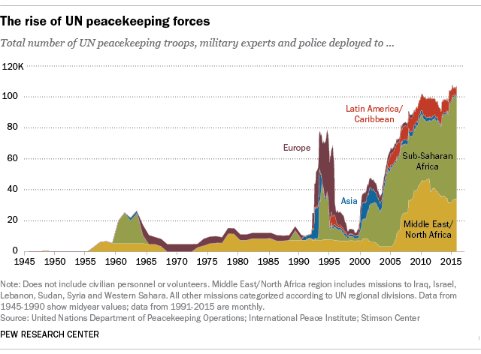

Slide 8
Expansion of International Law and International Institutions
Chemical Weapons Convention (1993/1997)
International Criminal Tribunal for the former Yugoslavia founded (25 May 1993)
International Criminal Tribunal for Rwanda founded (8 Nov 1994)
World Trade Organisation created (1995)
Ottawa Treaty (Anti-Personnel Mine Ban Convention) (1997)
Kyoto Protocol (1997/2005) (US refuses to ratify).
Rome Statute creates the International Criminal Court (1998/2002)
UN Resolution 1265 leads to the Protection of Civilians agenda, (1999)
ICISS releases its report, advancing the concept of the Responsibility to Protect (2001), UNSC Resolution 1674 affirms R2P (2006)
Creation of the UN Human Rights Council (2006)

Slide 9
Regionalism, Trade and Development
EU expansion: Austria, Finland, Sweden (1995), Cyprus, Czech Republic, Estonia, Hungary, Latvia, Lithuania, Malta, Poland, Slovakia, Slovenia (2004), Bulgaria, Romania (2007), Croatia (2013).
EU ‘wins’ US-EU Steel Tariffs dispute 2002-2003
Mercosur created (26 Mar 1991): Argentina, Brazil, Paraguay, Uruguay, Venezuela
NAFTA created (1 Jan 1994): USA, Canada, Mexico
ASEAN expansion: Vietnam (1995), Laos, Myanmar (1997), Cambodia (1999)
African Union created (May 2001/Jul 2002)
The ‘East Asian Miracle’ and the Four Asian Tigers (S. Korea, Taiwan, Hong Kong and Singapore)
Millennium Development Goals (2000)
But Asian Financial Crisis 1997, Global Financial Crisis 2007-8 and 2008-2012 global recession. UK votes to leave EU 23 June 2016.

Slide 10
Assessing Global Institutions

Slide 11
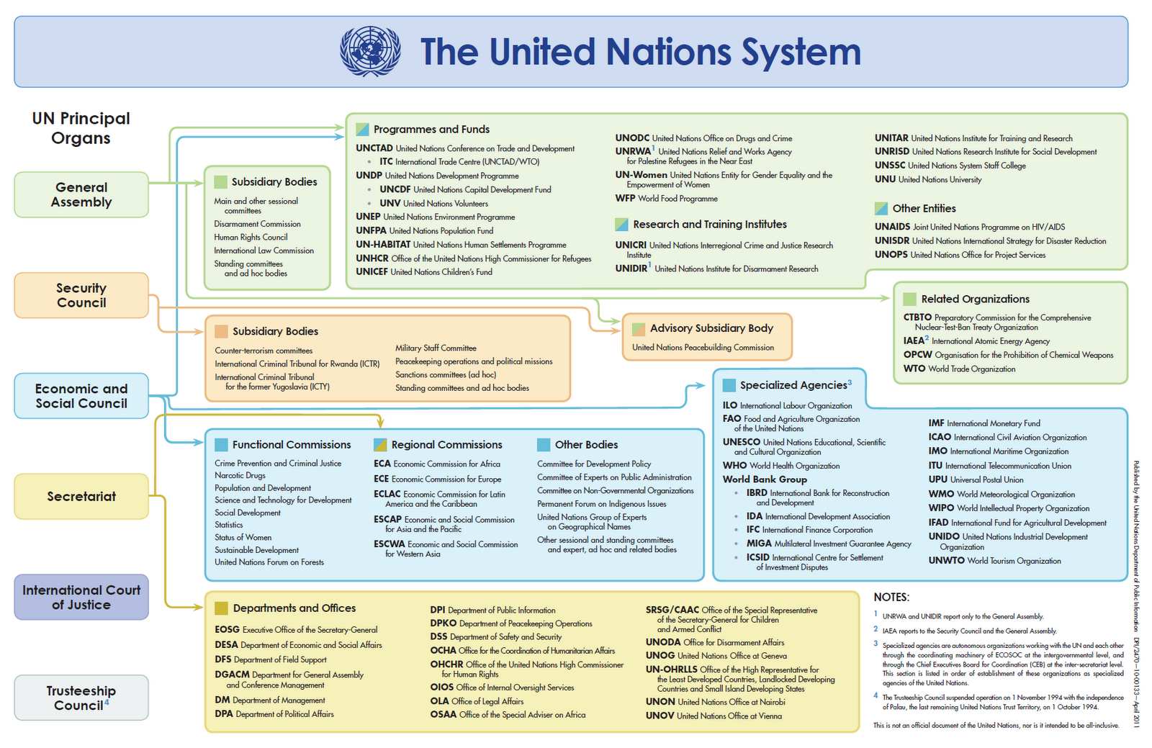

Slide 12
 | UN Security Council | International Monetary Fund | International Criminal Court
Purpose | Maintain international peace and stability | Originally: Maintain international monetary stability. Now: Manage financial crises, provide assistance loans, ensure debt-repayment | Prosecute (or support the domestic prosecution of) perpetrators of genocide, crimes against humanity, war crimes and aggression.
Governance | 5 Permanent Veto Members + 10 Elected Temporary Members | Managing Director, Board of Governors and Executive Board. Quota voting system gives more votes to largest creditors. | Assembly of State Parties elects judges and chief prosecutor. Judges elect a presidency.
Formal Independence | None – institution comprised of member states’ ambassadors. | Limited – Major policies controlled by state representatives, reforms spurred/blocked by major powers. | Significant – Decision-making directly exercised by independent elected judges, not member states directly.
Constrained by State Interests? | Mixed – states frequently block or ignore resolutions, but make regular use of UNSC even when this involves costs or no apparent direct national interest. | Mixed – US frequently blocks reforms, debt-servicing often overrides developmental aims, reforms largely only occur under member pressure, but NGOs/experts play a role. | Largely – Depends on state cooperation to apprehend indictees, indictments often ignored, several states (US, China, India, Russia) refuse to join.

Slide 13
Beyond States and International Organizations?
Theorists advocating alternative models of global governance typically very influenced by globalization theory. Various models:
Government networks and disaggregated states (Anne-Marie Slaughter)
Private Sector Regulators (Walter Mattli and Tim Büthe)
‘Corporatist’ NGO and IGO interactions (Kerstin Martens)
Transnational Civil Society (Mary Kaldor, Scott Turner)
Are these positive ways for democratizing world politics? Or new forms of elitist, technocratic control?

Slide 14
Key Questions
Why did ‘global governance’ expand in the 1990s and 2000s?
What gives international institutions their power?
Are states no longer the main actors in world politics?

